Slide 1
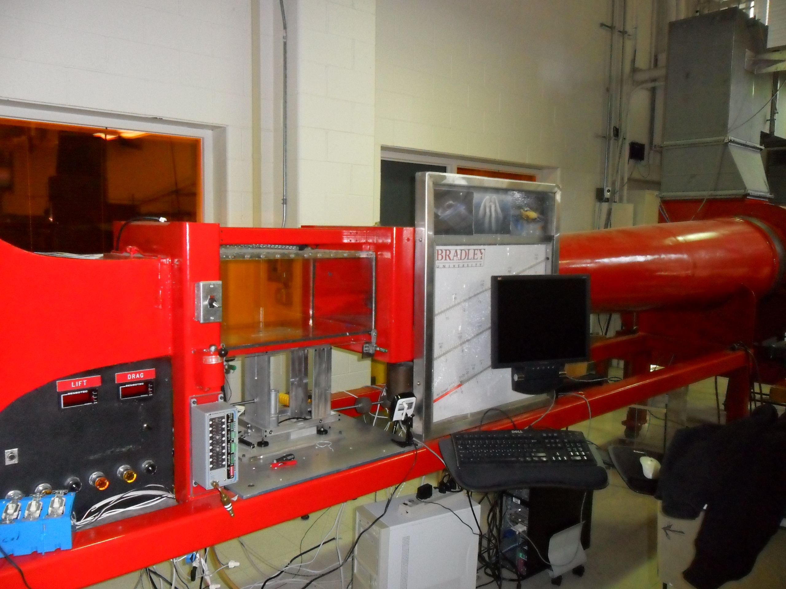
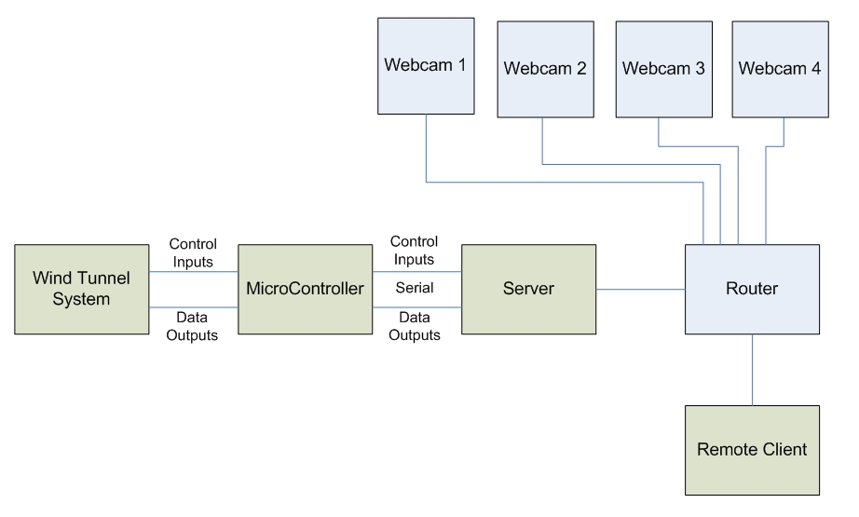
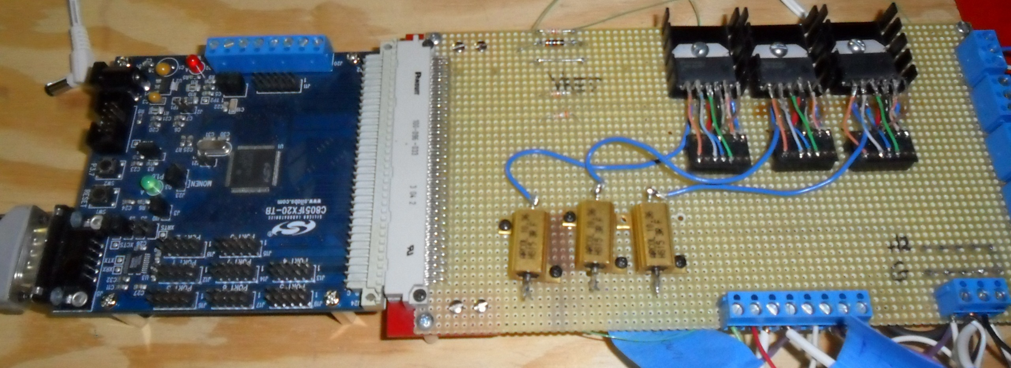
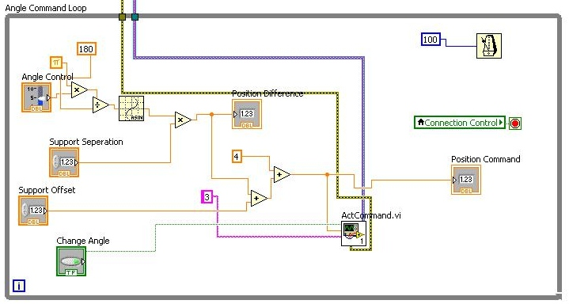
Automated Industrial Wind Tunnel
Work done by Nicholas Detrempe and Daniel Monahan Advised by Dr. Aleksander Malinowski
Project Description
System
The remote control system of the wind tunnel allows users to change angle and sensor position of objects in the wind tunnel. It also provides an interface for users to record data
A web server hosts the necessary application files so that a remote user can download them. The web server will also host web cams. This will give the users visual feedback in addition to the data they receive from the microcontroller
The system involved integrates the existing wind tunnel systems with an 8051 microprocessor which conveys data from the wind tunnel to a server machine.
Microprocessor
The primary purpose is to provide the wind tunnel users with a system to both collect data and to control the wind tunnel.
Secondary purposes involve
Learning and evaluating LabView as a programming basis
Providing a remote control system for the wind tunnel allowing viewing, controlling, and recording data from the remote system.
LabView
Description: Used LabView 2010 to develop the application. LabView is a graphical programming application. It allows users to “draw” code. It uses many of the same concepts such as while and for loops. Case statements and other logic devices are easily employed.
Pros:
Easy to read and determine purpose of programming
Data types are color coded – similar to syntax highlighting
Enables simple creation of VI’s or “functions” to coalesce code
Creating graphical user interfaces is very simple
Cons:
Graphical user interfaces are somewhat limited in variability
Development program is restricted: viewing is limited in scope
Loop and variable interoperability can cause frustration
Previous Work
Benjamin Morrison and Michael Firman (2010)
Performed system analysis and purchased H-bridges and Solid State Relays
Set up associated H-bridge circuitry
Adam Greene (2011)
Rewired H-bridges and added power resisters to help protect power dissipation
Added National Instruments D/A converter to communicate with PC – Required PCI LabView Card and specific machine
Developed microcontroller and labview software to work with the NI D/A converter
The microprocessor relays information to the server machine and accepts commands
Sensor Inputs:
Lift
Drag
Ambient Temperature
Ambient Air Pressure
Wind Tunnel Air Pressure
Three Actuator Potentiometers
Control Outputs:
Main Blower On/Off
Damper Open/Close (Wind Speed Up/Down)
Actuator Position (Closed loop control of
actuator based on potentiometer reading)
Safety precautions coded into the programming of the microcontroller to prevent damage to both the microcontroller and associated circuitry and to objects in the wind tunnel
Java Server
The Java server runs on the local wind tunnel computer.
Communicates with the microcontroller via RS232;
Accepts TCP connections to allow local and remote clients to control the wind tunnel and to collect data
Sends and Receives data in string format to allow for variability in client software

